Slide 1


”
MCA III SEM
MINI PROJECT VIVA VOCE
NOV 2025
Utkarsh Srivastava
EA2432251010355
DATE : 06-12-2025

Slide 2
Title
The “Job Portal (Web Application)”

Slide 3

CONTENTS
Abstract
Introduction
Problem Description
Design Phase
Implementation Phase
Screenshots
Conclusion
References

Slide 4
ABSTRACT
The “Job Portal (Web Application)” is designed to provide a common platform for job seekers and employers. The main objective of this project is to simplify the recruitment process by enabling employers to post job openings and candidates to search for and apply for suitable opportunities online.
The system allows job seekers to register, create and manage their profiles, upload resumes, and search for jobs based on skills, location, and domain. Employers can register, create company profiles, and post job vacancies with detailed requirements. The application also supports job applications tracking and basic communication between candidates and employers.
Technologies used for the development include HTML, CSS, JavaScript with React.js as a framework for the frontend, Node.js for backend, and MongoDB as the database. This project demonstrates -
real-world software development practices such as authentication, CRUD operations, and database connectivity.
In the future, the system can be enhanced with advanced features like AI-based job recommendations, resume parsing, and email notifications.

Slide 5

INTRODUCTION
In today’s competitive world, the recruitment process has become a crucial activity for both employers and job seekers. Traditional methods of job searching and hiring, such as newspaper advertisements or offline recruitment agencies, are often time-consuming, inefficient, and limited in reach. To overcome these challenges, online job portals have emerged as a practical solution, providing a digital platform that connects job seekers with potential employers.
The proposed “Job Portal (Web Application)” aims to simplify and streamline the hiring process by enabling employers to post job vacancies and candidates to search, apply, and track opportunities online. The system is designed with a user-friendly interface, ensuring easy accessibility for both parties. Job seekers can create profiles, upload resumes, and search for jobs based on criteria such as skills, domain, and location, while employers can manage company profiles and post job requirements effectively.
This project demonstrates the application of modern software development techniques, integrating frontend, backend, and database technologies. It not only provides a basic recruitment platform but also lays the foundation for advanced features such as AI-based job recommendations, resume parsing, and secure communication between candidates and employers.
By implementing this system, the recruitment process becomes faster, more transparent, and accessible, thus benefiting both job seekers and organizations in achieving their objectives.

Slide 6
Problem Description
In the traditional recruitment process, job seekers rely on newspapers, employment agencies, or personal networks to find opportunities, while employers often face difficulties in reaching suitable candidates. These methods are time-consuming, costly, and lack transparency. Additionally, job seekers cannot easily track their applications, and employers struggle with managing large volumes of resumes offline.
To overcome these challenges, the Job Portal (Web Application) is proposed as an online solution. It provides a centralized platform where job seekers and employers can interact. Job seekers can register, create profiles, upload resumes, and apply for jobs. Employers can post vacancies, review applications, and manage company information. The system reduces manual effort, increases transparency, and enhances accessibility

Slide 7
Module Description
Job Seeker Module
Register and login to the system.
Create and manage profile including personal details, skills, and resume.
Search for jobs by title, location, or skill.
Apply for jobs and track application status.
Employer Module
Register and login as an employer.
Create and manage company profile.
Post new job vacancies with detailed requirements.
View applications and shortlist candidates.
Communication Module (Optional)
Enable communication between job seekers and employers.
Provide notifications or updates on job applications.
Support for email alerts and system messages

Slide 8
Design
System Architecture
The Job Portal Web Application follows a three-tier architecture, which divides the system into three logical layers:
Presentation Layer (Frontend):
- Developed using HTML, CSS, and React.js.
- Handles user interactions, registration, login, job search, and job posting interfaces.
- Communicates with the backend via HTTP requests (GET/POST).
Application Layer (Backend):
- Implemented using Node.js .
- Manages all the business logic such as authentication, job posting, and application tracking.
- Performs validation and interacts with the database.
Database Layer:
- Built on MongoDB.
- Stores information about users, jobs, companies, and applications.
- Ensures data integrity and supports CRUD operations.

Slide 9
Implementation
The implementation phase converts the design into a functional system. The Job Portal Web Application was developed using modern web technologies ensuring scalability, maintainability, and usability.
1. Frontend Implementation
The user interface (UI) is designed using HTML, CSS, and JavaScript.
Responsive design ensures the portal works smoothly on desktops and mobile devices.
The frontend communicates with the backend via HTTP requests using AJAX / Fetch API.
Key Features Implemented:
User Registration and Login Pages
Employer Dashboard for Job Posting
Job Seeker Dashboard for Application Tracking
Search and Filter Functionality
Admin Panel for Management
2. Backend Implementation
The backend handles business logic, data validation, and database operations.
Developed using Node.js
RESTful APIs were implemented for communication between the client and the server.
Proper authentication and authorization were implemented using sessions/tokens.
.

Slide 10
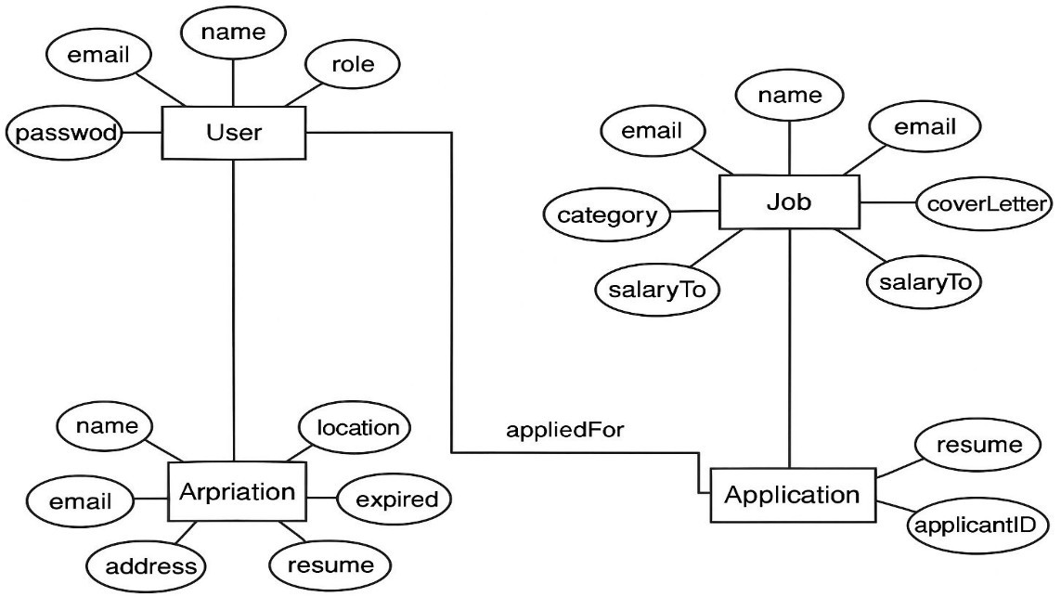
ER Diagram
.

Slide 11
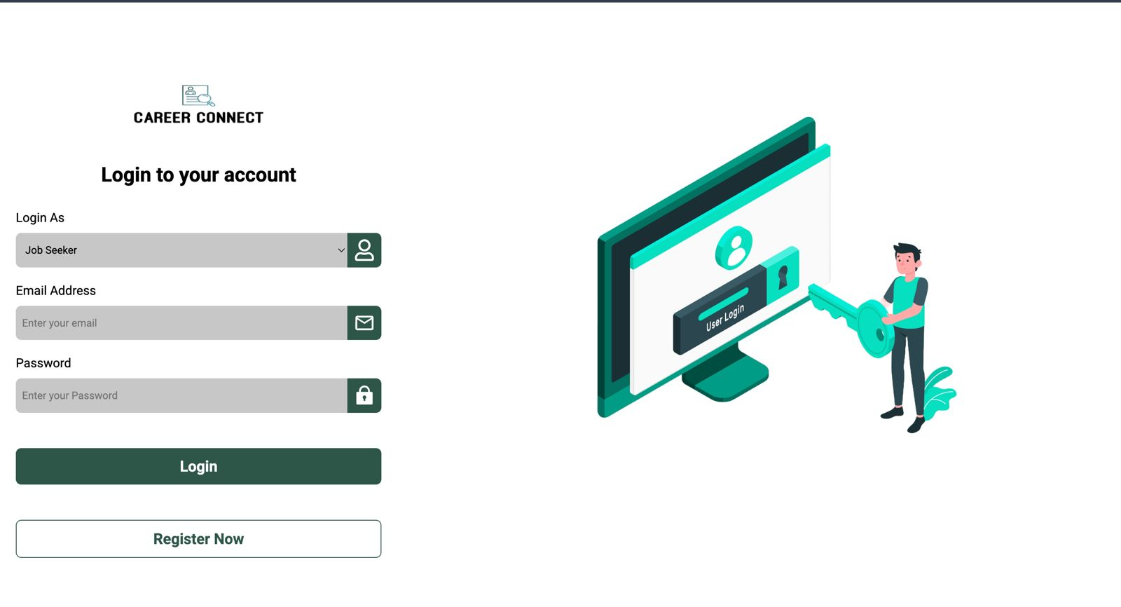
INPUT/OUTPUT/SCREENSHOTS
JobSeeker - Login

Slide 12
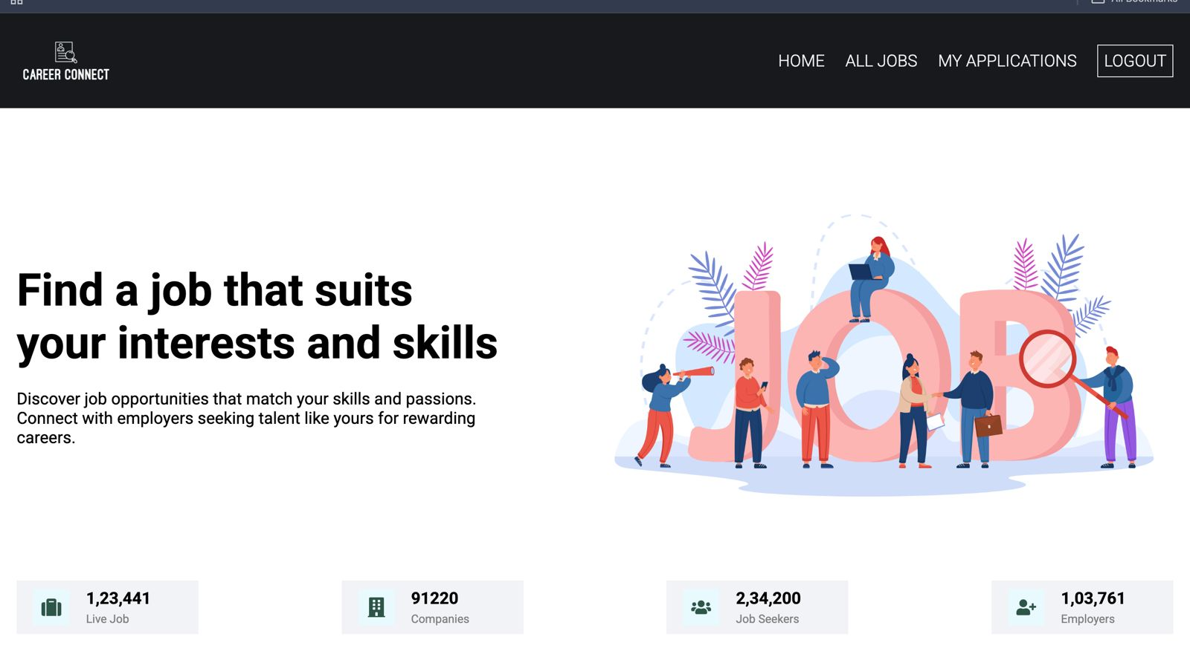
Home Page

Slide 13
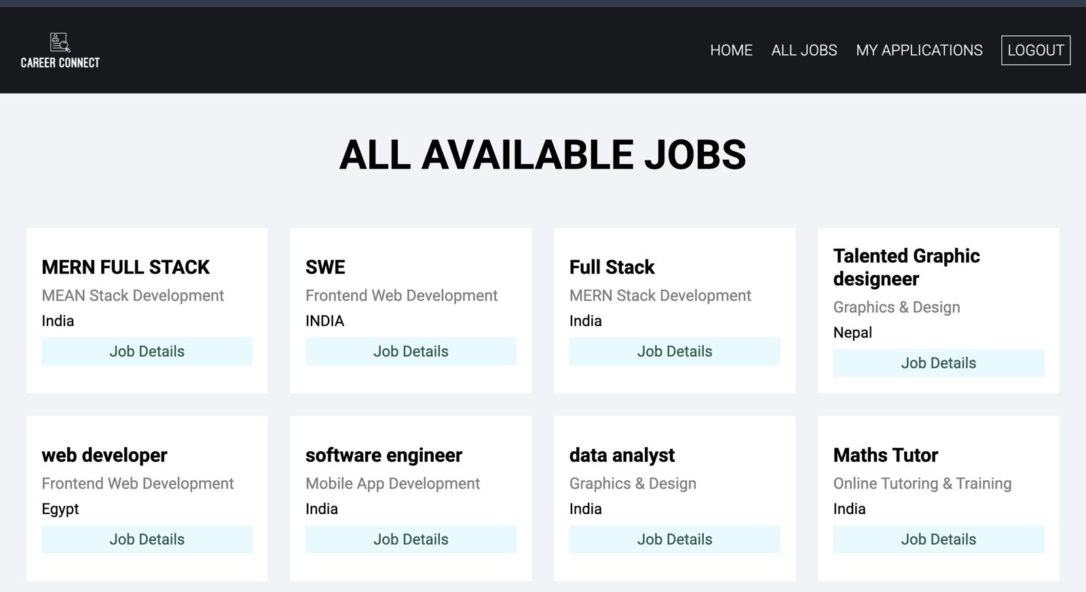
All Jobs

Slide 14
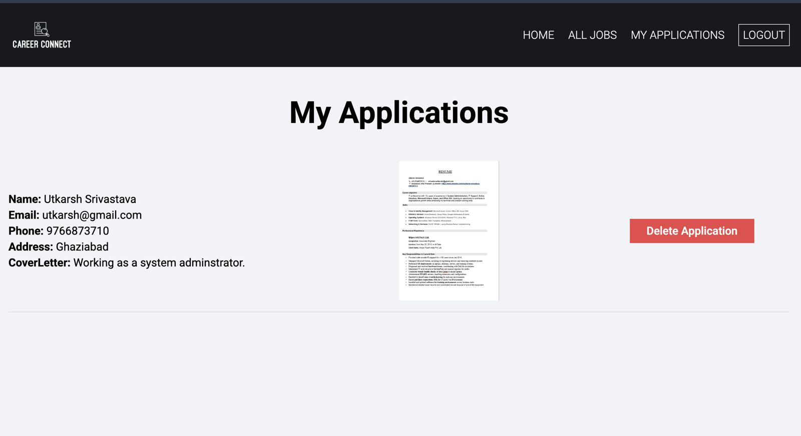
Job Applied

Slide 15
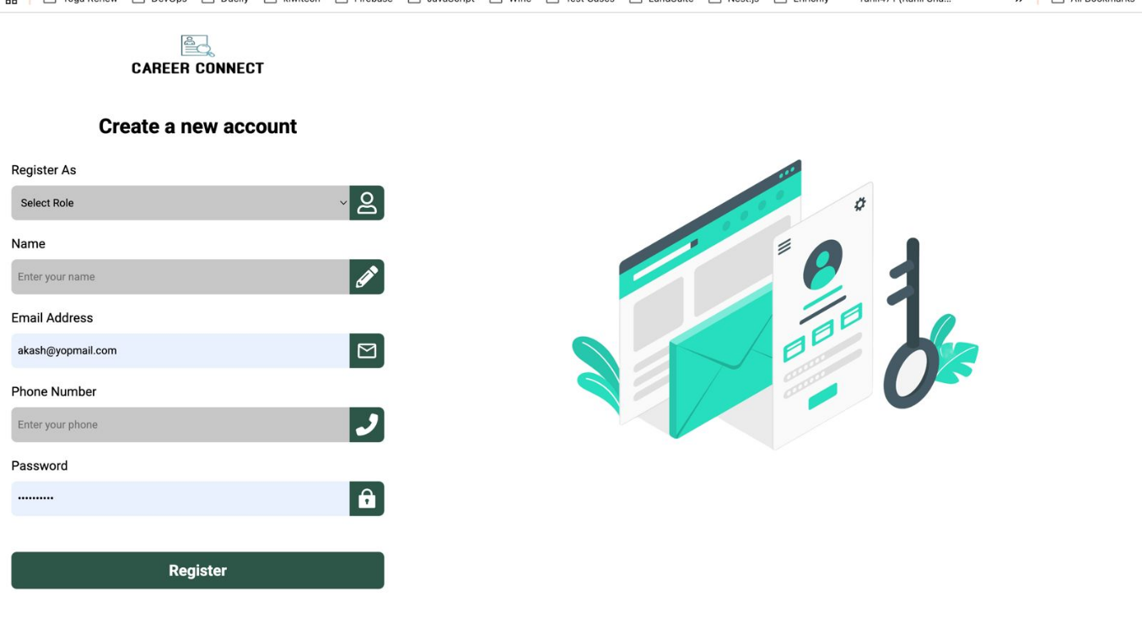
Recruiter - Sign Up

Slide 16
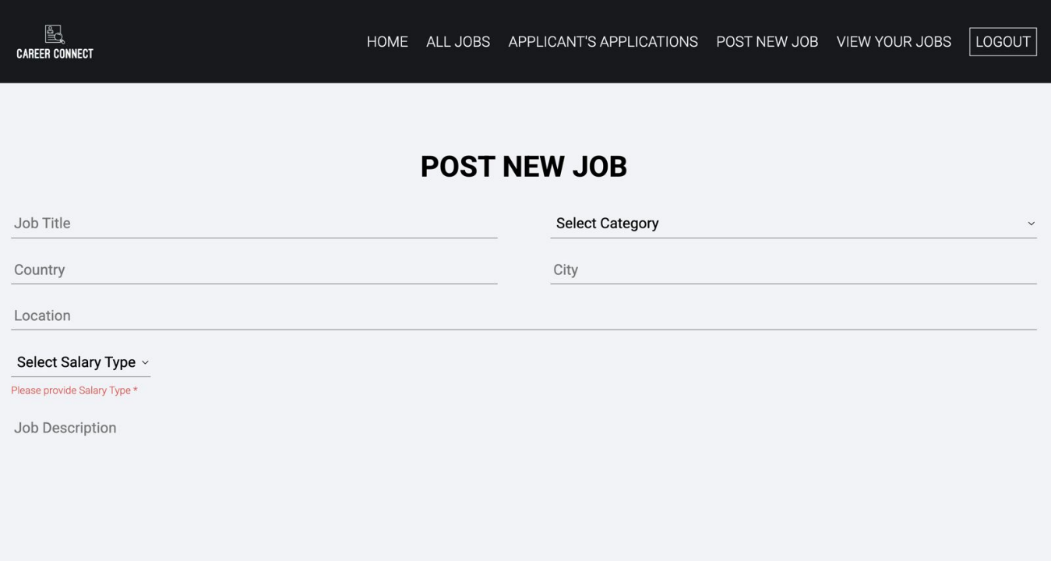
Recruiter Job Posting

Slide 17
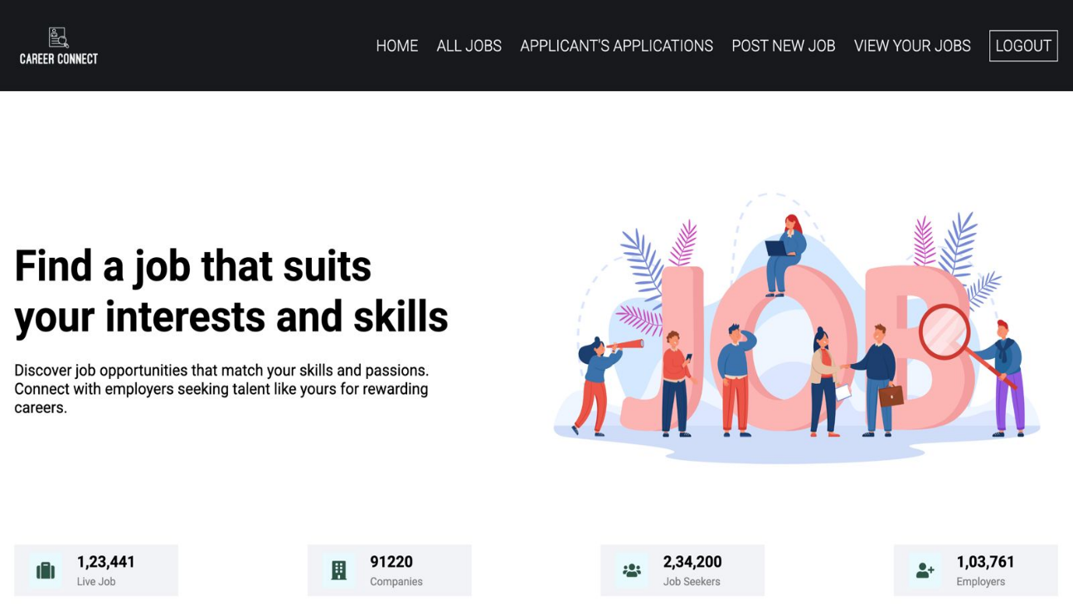
Recruiter – Home Page

Slide 18
CONCLUSION
The Job Portal (Web Application) project provides an efficient and user-friendly platform that bridges the gap between job seekers and employers. It eliminates the limitations of traditional recruitment methods by digitizing the entire hiring process. Job seekers can easily search and apply for jobs, while employers can post vacancies and manage recruitment activities in a structured way. The system leverages modern web technologies to ensure scalability, security, and accessibility. Overall, the Job Portal project successfully demonstrates how technology can simplify and enhance the recruitment process, making it faster, transparent, and more effective for both parties.

Slide 19
References
MongoDB Documentation. (2024). NoSQL Database for Modern Applications. Retrieved from https://www.mongodb.com/docs/
Express.js Official Documentation. (2024). Fast, unopinionated, minimalist web framework for Node.js. Retrieved from https://expressjs.com/
React.js Documentation. (2024). A JavaScript library for building user interfaces. Retrieved from https://react.dev/
Node.js Documentation. (2024). Node.js JavaScript runtime built on Chrome’s V8 JavaScript engine. Retrieved from https://nodejs.org/en/docs
Bootstrap Official Documentation. (2024). Front-end component library for responsive web design. Retrieved from https://getbootstrap.com/docs/
Cloudinary Developer Guide. (2024). Media management and optimization platform. Retrieved from https://cloudinary.com/documentation
JWT.io. (2024). Introduction to JSON Web Tokens for Secure Authentication. Retrieved from https://jwt.io/introduction/
MDN Web Docs. (2024). JavaScript and Web Development Tutorials and References. Retrieved from https://developer.mozilla.org/
GeeksforGeeks. (2024). MERN Stack Development Tutorial Series. Retrieved from https://www.geeksforgeeks.org/mern-stack/
FreeCodeCamp. (2024). Full Stack Web Development Guide using MERN Stack. Retrieved from https://www.freecodecamp.org/

Slide 20
THANK YOU

